Slide 1
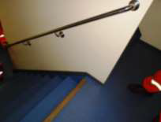
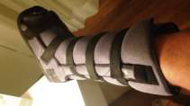
HS&E INCIDENT BULLETIN |  | 1st half year 2017
Offshore, Brazil | Type of incident (Ankle Sprain – Slip, Trip and Fall)
Summary:
A Field Service Representative was working on an offshore platform. He was descending the stairs from one floor to another floor when he injured his right ankle. Medical personnel attended to him on the platform where he was then sent onshore for further evaluation. An x-ray was taken and was negative for a fracture. The employee was diagnosed with a sprained ankle and will be out of work for at least 10 days for recovery.
Root Causes: | Actions Taken Thus Far: Next Steps
Stair design – The steps are very short (i.e. low tread depth). Stair surface – Anti-slip material is only installed on the top step. Note: Investigation revealed that the employee’s shoes were appropriate and in good condition and he was using the handrail. | Immediate communication occurred to notify appropriate personnel of the incident. On-board medical attention was provided; Management then decided to send the employee for further medical evaluation onshore in Rio de Janeiro. Recommendations were communicated to the platform supervisor to improve the design of the stairs (as they are very short steps) and to add anti-slip material to the stairs. The global Slips, Trips and Falls policy was reinforced with all employees.

